Slide 1
Module 03 Case studies

Slide 2
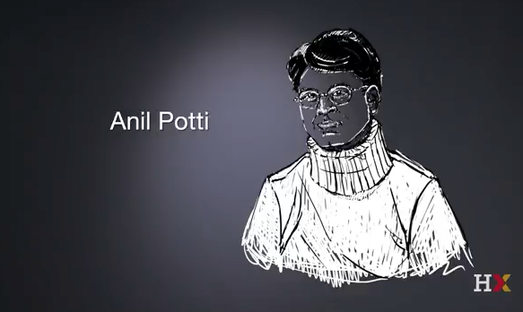

Slide 3
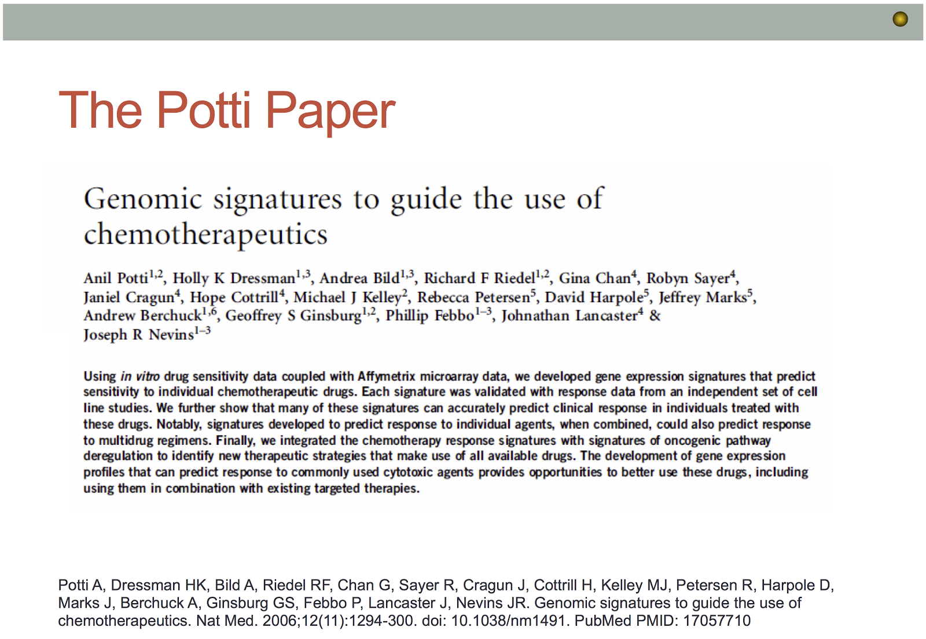

Slide 4
In this context, Prof. Quackenbush defined precision medicine as the use of the specific genomic characteristics of a tumor to help identify the most appropriate drugs for treating it. Q: How is this particular study an example of precision medicine?

Slide 5
In this context, Prof. Quackenbush defined precision medicine as the use of the specific genomic characteristics of a tumor to help identify the most appropriate drugs for treating it. Q: How is this particular study an example of precision medicine? A: Potti et al claim to combine "in vitro drug response data" and "microarray gene expression data" to predict the response of a tumor to "cytotoxic chemotherapeutic drugs" and combinations thereof, in a way "that best matches the characteristics of the individual".

Slide 6
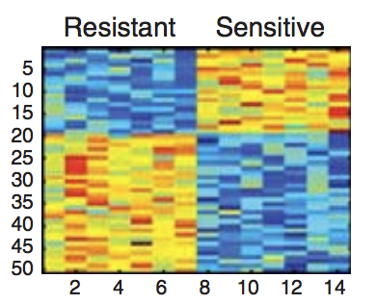
Q: The expression of how many genes are summarized by this figure?

Slide 7
Q: The expression of how many genes are summarized by this figure? A: The caption tells us that "each row represents an individual gene". There appears to be 50 rows in this figure, implying that there are 50 genes summarized by this figure.

Slide 8
Q: How many total cell lines are represented in this figure? How many of these cell lines are resistant to docetaxel (i.e., are not killed off by docetaxel)? How many of these cells lines are sensitive to docetaxel (i.e., are killed by docetaxel)?

Slide 9
Q: How many total cell lines are represented in this figure? How many of these cell lines are resistant to docetaxel (i.e., are not killed off by docetaxel)? How many of these cells lines are sensitive to docetaxel (i.e., are killed by docetaxel)? A: There are 14 cell lines in this figure, where cell lines 1 through 7 are resistant and lines 8 through 14 are sensitive.

Slide 10
Q: Complete the following sentence: Looking at genes 1 through 19, the figure implies that expression of these genes is high/low in the resistant cell lines and high/low in the sensitive cell lines.

Slide 11
Q: Complete the following sentence: Looking at genes 1 through 19, the figure implies that expression of these genes is high/low in the resistant cell lines and high/low in the sensitive cell lines.

Slide 12
Q: Complete the following sentence: Looking at genes 20 through 50, the figure implies that expression of these genes is high/low in the resistant cell lines and high/low in the sensitive cell lines.

Slide 13
Q: Complete the following sentence: Looking at genes 20 through 50, the figure implies that expression of these genes is high/low in the resistant cell lines and high/low in the sensitive cell lines.

Slide 14
Q: Gene 5 appears to be highly expressed in sensitive cell lines, but has relatively low expression in resistant cell lines. Thus if a cell line was treated with docetaxel and we later found that there was low expression of Gene 5, would this suggest that this cell line is sensitive or resistant? If a person was found to have Gene 5, would docetaxel be a good chemotherapeutic option?

Slide 15
Q: Gene 5 appears to be highly expressed in sensitive cell lines, but has relatively low expression in resistant cell lines. Thus if a cell line was treated with docetaxel and we later found that there was low expression of Gene 5, would this suggest that this cell line is sensitive or resistant? If a person was found to have Gene 5, would docetaxel be a good chemotherapeutic option? A. No because the gene is indicative of a cell line that is resistant to the drug

Slide 16


Slide 17
Forensic Bioinformatics Concerns of Coombes et al (2007) in trying to reproduce Potti et al (2007) results.
1. We cannot reproduce [Potti’s] selection of cell lines.
2. The list of genes initially reported … are wrong.
3. Using their software and lists of cell lines, we reproduced their published heatmaps for six out of seven drugs.
4. For docetaxel, ... software [of Potti et al] yields only 31 of their 50 reported genes.
5. Their software does not maintain the independence of training and test sets, and the test data alter the [regression] model.
6. The interaction between point 4 (using an incorrect gene list) and point 5 (mixing training and test sets) can produce ‘better than chance’ predictions in the wrong direction.
7. When we apply the same methods but maintain the separation of training and test sets, predictions are poor. Simulations show that the results are no better than those obtained with randomly selected cell lines.

Slide 18
Baggerly and Coombes 2007 Microarrays: retracing steps. Nature Medicine 13(11):1276-7
Page 1277, right column
“We do not believe that any of the errors we found were intentional. We believe that the paper demonstrates a breakdown that results from the complexity of many bioinformatics analyses. This complexity requires extensive double-checking and documentation to ensure both data validity and analysis reproducibility. We believe that this situation may be improved by an approach that allows a complete, auditable trail of data handling and statistical analysis. We use Sweave4,5, a package that allows analysts to combine source code (in R)6 and documentation (in LaTeX)7 in the same file. Our Sweave files are available at (http://bioinformatics.mdanderson.org/Supplements/ReproRsch-Chemo/). Running them reproduces our results and generates figures, tables and a complete PDF manuscript.”

Slide 19
Q: Baggerly and Coombes summarize the conclusions of their forensic bioinformatic investigation in the above paragraph, by making suggestions about how to create “a complete, auditable trail of data handling and statistical analysis”. What are the specific recommendations that they make? How might you include these recommendations in your own work?

Slide 20
Q: Baggerly and Coombes summarize the conclusions of their forensic bioinformatic investigation in the above paragraph, by making suggestions about how to create “a complete, auditable trail of data handling and statistical analysis”. What are the specific recommendations that they make? How might you include these recommendations in your own work? A: The authors suggest the combination of source code and documentation to allow a reader to follow the analyses performed. The authors use Sweave, a method that allows analysts to combine R source code and documentation in the same file. In this way, the code from the analysis is run, figures and tables are generated directly, and a reader is able to see exactly how the figures and tables were generated. There are other tools that allow for combination of source code and documentation, e.g., GitHub, Rmarkdown and Jupyter notebooks.

Slide 21
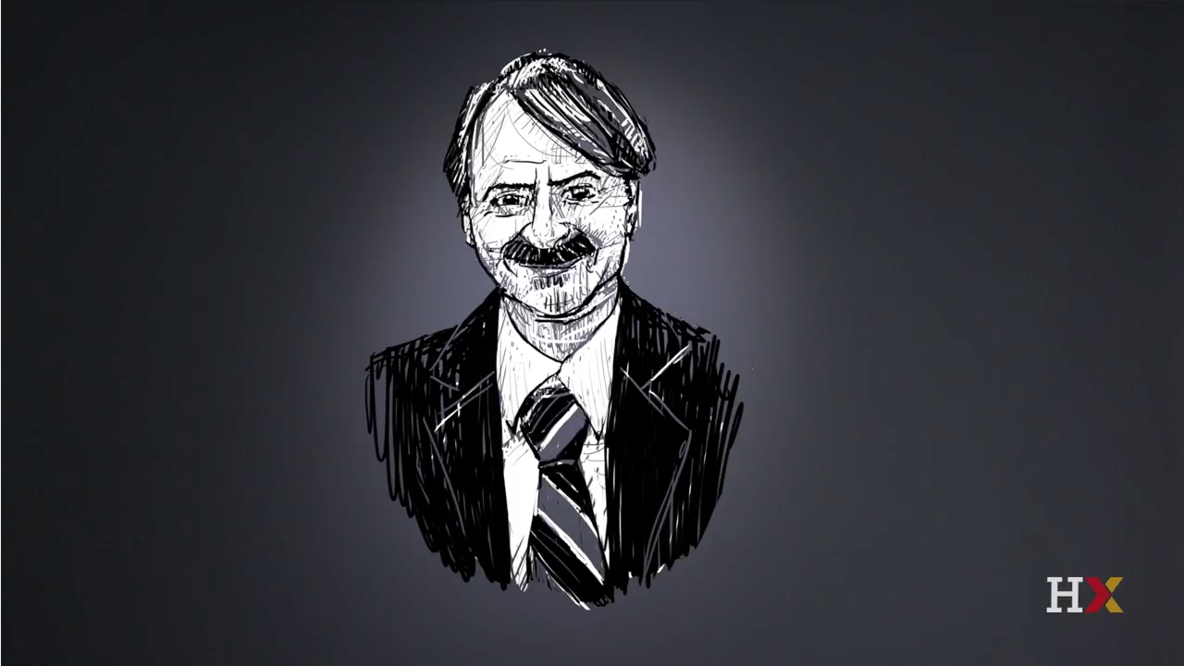
Ioannidis

Slide 22
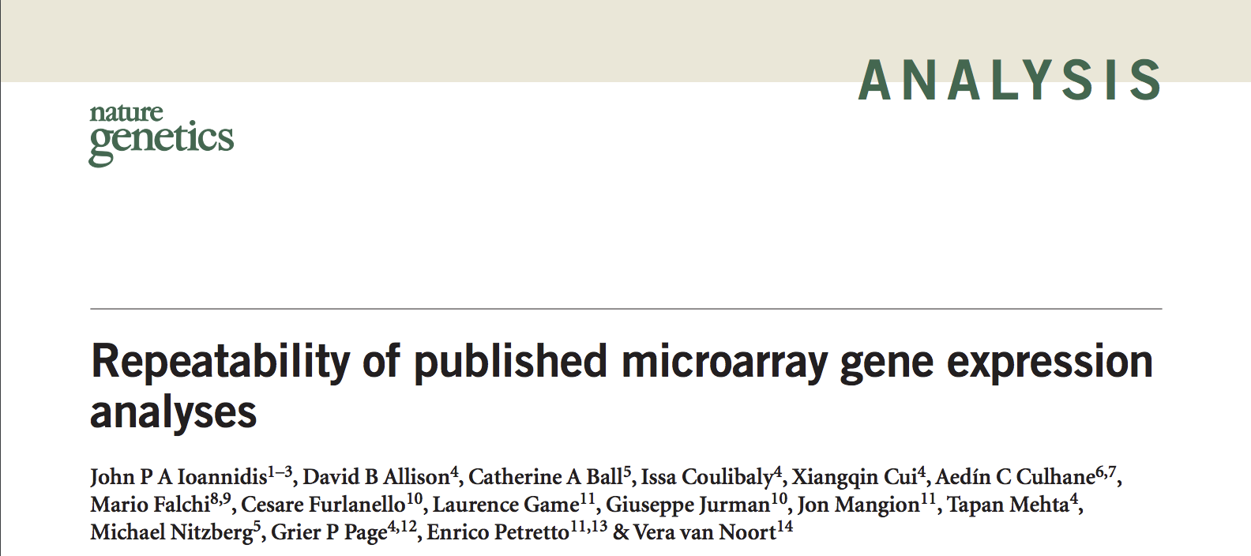

Slide 23
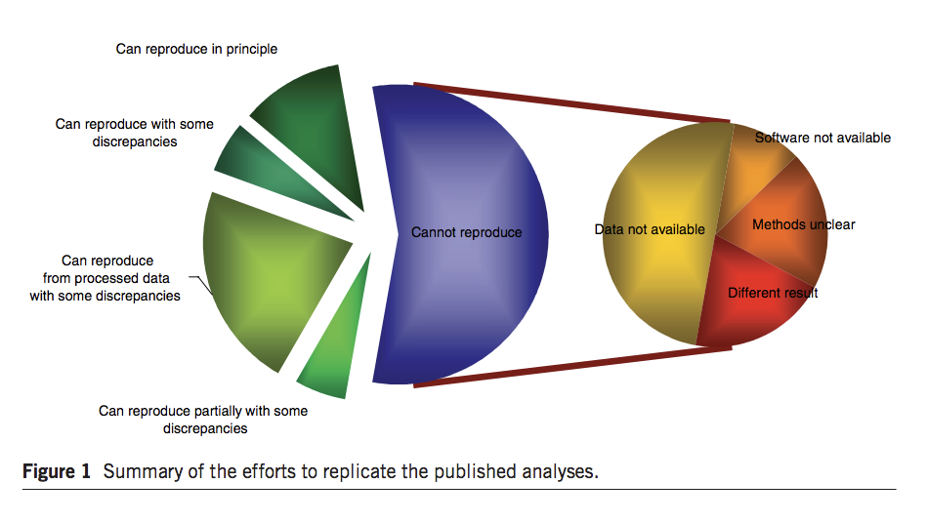

Slide 24
Page 150, right column (bottom) In the overall effort to reproduce the results of the 18 specified tables and figures (Table 3 and Fig. 1), the selected analyses could be said to be ‘reproduced in principle’ (that is, the differences in results obtained by our teams of analysts and those reported in the original paper were felt to be minor) in only two cases; in another six cases, the analyses were reproduced with some discrepancies, and moreover, in one of these six, only partial reproduction of some of the data and panels was possible. Finally, in ten articles, the selected analyses could not be reproduced.

Slide 25
Page 150, right column (bottom) In the overall effort to reproduce the results of the 18 specified tables and figures (Table 3 and Fig. 1), the selected analyses could be said to be ‘reproduced in principle’ (that is, the differences in results obtained by our teams of analysts and those reported in the original paper were felt to be minor) in only two cases; in another six cases, the analyses were reproduced with some discrepancies, and moreover, in one of these six, only partial reproduction of some of the data and panels was possible. Finally, in ten articles, the selected analyses could not be reproduced. Q: Does the authors’ inability to reproduce the results of the 18 selected studies mean that the results in these 18 studies are wrong?

Slide 26
Page 150, right column (bottom) In the overall effort to reproduce the results of the 18 specified tables and figures (Table 3 and Fig. 1), the selected analyses could be said to be ‘reproduced in principle’ (that is, the differences in results obtained by our teams of analysts and those reported in the original paper were felt to be minor) in only two cases; in another six cases, the analyses were reproduced with some discrepancies, and moreover, in one of these six, only partial reproduction of some of the data and panels was possible. Finally, in ten articles, the selected analyses could not be reproduced. Q: Does the authors’ inability to reproduce the results of the 18 selected studies mean that the results in these 18 studies are wrong? A: No; “confirming or disproving these published analyses and evaluating their correctness was not our intention” (pg 151). The authors were ONLY looking at the repeatability of the results. Checking for scientific correctness would involve a more thorough investigation into the scientific reasoning behind the experiments + how the data were generated + whether the analyses chosen were appropriate.

Slide 27
Q: In reviewing Table 3, “Summary of efforts at reproducing the published results”, what is a best practice that you will now implement in your research, after reading about the difficulties of the Ioannidis team?

Slide 28
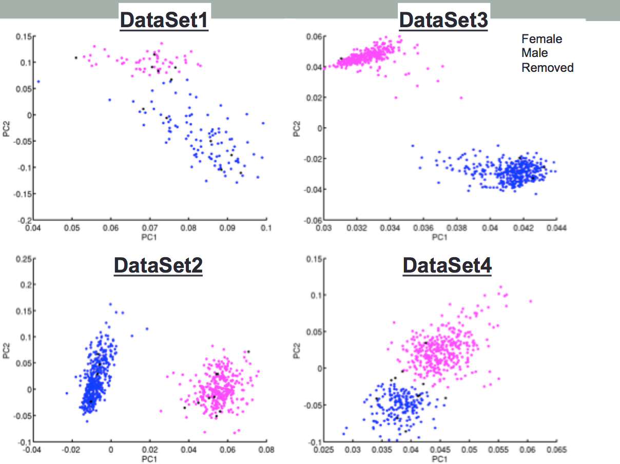
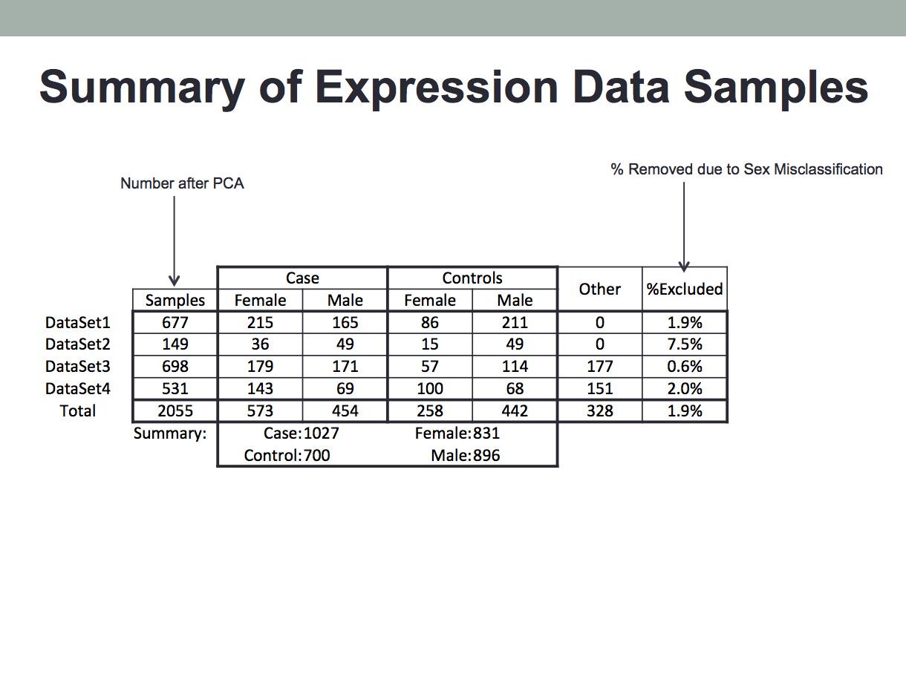
Checking Annotations

Slide 29
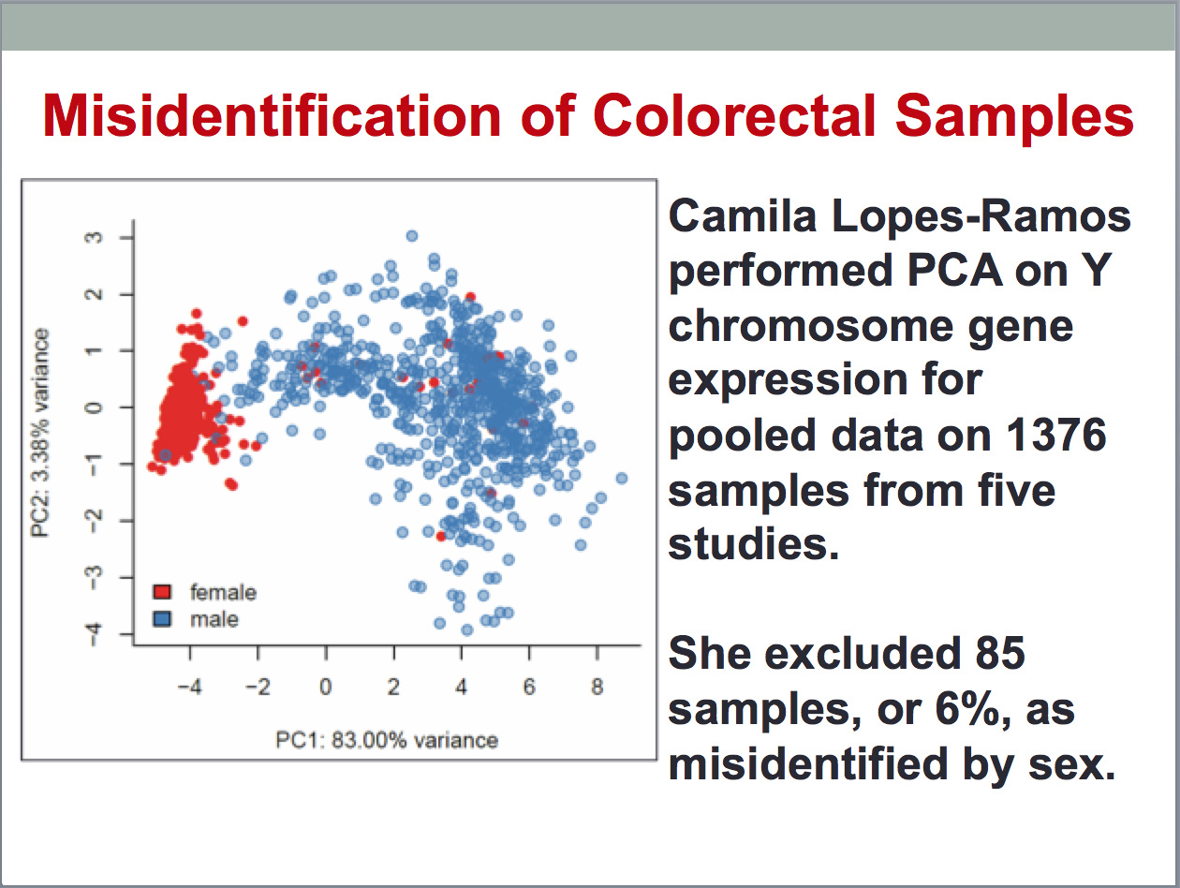

Slide 30
Journals and Reproducible Research

Slide 31
Journals support reproducibility Principles and guidelines for supporting preclinical research
1. Encourage rigorous statistical analysis.
2. Transparency in reporting.
Use of checklists during the editorial processing to ensure reporting of key methodological and analytical information is available to reviewers and readers.
3. Adherence to data and material sharing policies.
4. Better consideration of refutations.
5. Establish best practice guidelines for image-based data, and for descriptions of biological materials.

Slide 32
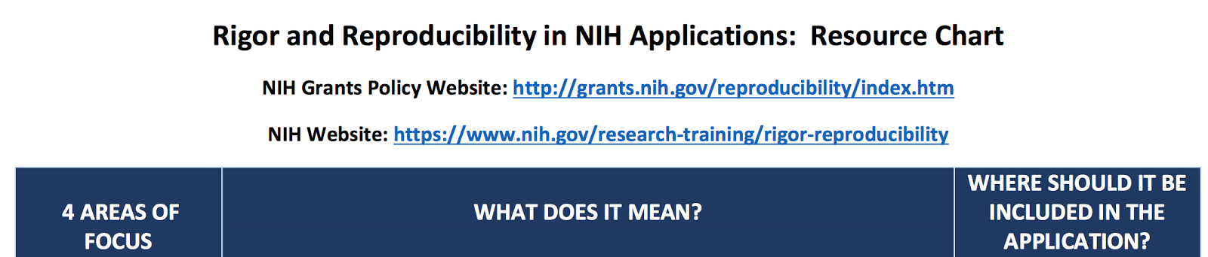
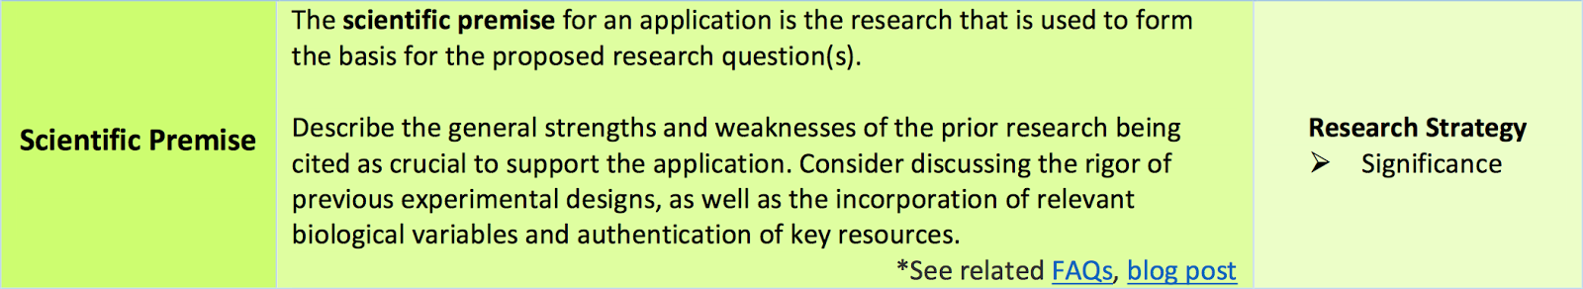
NIH Guidance on Reproducible Research

Slide 33

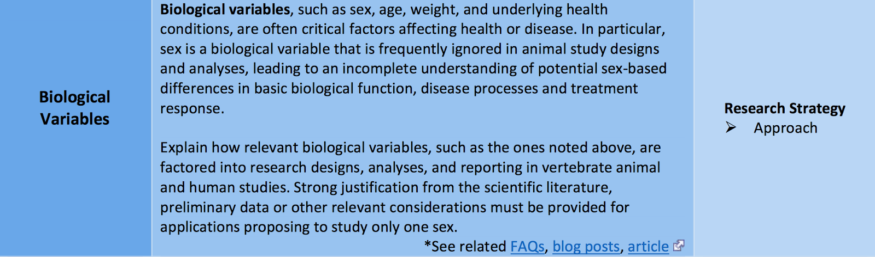

Slide 34
